Slide 1
Meditation and Culture: Self-Cultivation, Context, and Social Imaginaries
David McMahan
Franklin & Marshall College
Hebrew University
May 12-14, 2019
Notes:
[Intro comments]
I want to think about the broad issue of the importance of considering context as an essential part of meditative practices, not just something extra added on

Slide 2
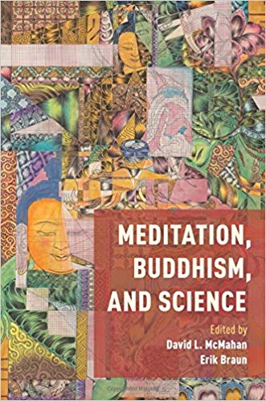
Notes:
My thinking about the issue began with considering this issue in response to the increasingly dominant ways of thinking about meditation in scientific terminology
-Erik Braun and I put together an edited vol. re-emphasizing the importance of humanistic and social thought about meditation, and much of this was about reaffirming the importance of social, cultural, and ethical context when giving an account of meditative practices

Slide 3
The scientific study of contemplative practices often neglects the role of cultural, historical, social, political, religious, and ethical context
Isolating these practices from these contexts for the sake of scientific study may inevitably distort how they actually work in people’s lives.
We cannot make sense of contemplative practices in isolation from these contexts; that they are inextricably, systemically intertwined with them
Notes:
I want to suggest that the scientific study of these practices—because of the need to operationalize—often neglects the role of cultural, historical, social, political, religious, ethical context —and that it’s impossible to have an adequate understanding of these practices without the study of these contexts
-further, when we think of “context,” we’re often thinking of something “extra,” added to practices and the states of mind that they produce
-something that gives different hues and nuances to states of mind that essentially are what they are
-in contrast to this view, I want to argue contemplative practices are inextricably, systemically intertwined with them
-people who do contemplative practices are inevitably part of cultures, subcultures who occupy particular places in a society, and their very understanding of what they’re doing when they practice, what their goals are (or why they might say they have no goals), their very understanding of what kind of beings they are in what kind of cosmos – all of this is informed by social, cultural, and historical context and must be understood through humanistic and social inquiry

Slide 4
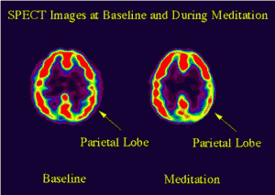
Notes:
We tend to think of contemplative practices as leading to certain experiences or internal mental states, which correspond to certain brain states, which can then be discerned and measured through various visualizing technologies – fMRI, pet scans, etc.
So doing practice A creates state of mind/brain X, after which the diligent practitioner will enter the next levels: states of mind Y and Z.
-on this model, any practitioner in any cultural context would do a particular practice and get the brain into that particular state
-and further, we have to operationalize, weed out contextual factors in order to see what the bare practice itself does; what experiential state/brain state it produces
The conundrum is that this very process of de-contextualization that scientific rigor demands may itself be distortive of the lived experience of practitioners

Slide 5
Contemplative practices as technologies of self-cultivation or self-transformation that aim at creating particular ways of being-in-the-world
-a particular cultural “lifeworld” (lebenswelt) or “social imaginary”
Notes:
Instead of conceiving of meditative practices in terms of “brain-states” or states of mind that are the same at all times and places, I suggest seeing them more broadly as technologies of self-cultivation or self-transformation that aim at creating particular ways of being in the world – or more specifically a world, a lifeworld.
-“world” in the phenomenological sense of a “lifeworld” (lebensweld), not as a location or set of physical entities but our primary lived experience of our world. “World” in this sense is not the world of molecules, electrons, and quarks. It is rather the world of things that are charged with meaning, feeling, significance—much of it supplied by a particular social and cultural context.

Slide 6
Social Imaginary
Beliefs
Ethics
Goals
Concepts
Values
Social forms
Cultural habits & norms
Customs
Default intuitions
Large-scale social-political structures
Institutions
Physical conditions
Cosmology
Notes:
Social imaginary (imaginaire) (Charles Taylor) In the broadest sense, the background of an intersubjectively shared lifeworld.
Nested contexts:
1. Immediate context in which meditation is done
Explicit ideas that inform what one is actually doing when one does a particular practice; why one does it; explicit philosophical or religious context, the values inherent in it, the ethical judgments; what constitutes success, failure, progress
2. Another element of social imaginary
It is constituted by a repertoire of concepts, attitudes, social practices, customs, ethical dispositions, power relations. It determines what is normative, what is taken for granted, what goes without saying—one’s default intuitions.
3. Social and political structures, structures of authority (democracy, caste system); wealth, poverty
4. But I would extend it to a cosmological context as well—how one imagines one’s place in the world in the widest possible sense.
So even with the simplest of practices, like breath awareness, we have to consider not just how these practices work on the level of universal physiological structure and function, but also the work that these practices do in the social imaginary of practitioners

Slide 7

Notes:
Examples:
Contemporary Vipassana practitioner
Let’s say she is an educated, white, middle-class businesswoman who earns a comfortable living and lives with her husband and children.
-meditates nearly every day, and attempts to maintain mindfulness throughout her daily activities.
describes her practice as “spiritual” not religious, but also good for her physical and mental health. She eats mindfully in order to appreciate her meals more fully is selective with her foods.
-view of the world is informed by modern science and has little room for supernatural beings, miracles, heavens, or hells. She is encouraged in her practice by studies that suggest that it will change her brain in ways that will improve her performance in many areas of her life. Her practice eases the anxieties of her hectic life of negotiating a frenetic work schedule and family obligations. It makes her more patient with her children, more compassionate with her coworkers, more focused in performing her many tasks, clearer-minded with regard to personal problems, and less likely to be overwhelmed by negative emotions. Meditation helps her to focus on the present and not dwell on the past or obsess about the future. She also likes theatre and music, which she considers integral parts of her spiritual life. [notice the ethical direction here: toward family, work, aesthetic enjoyment, etc]

Slide 8
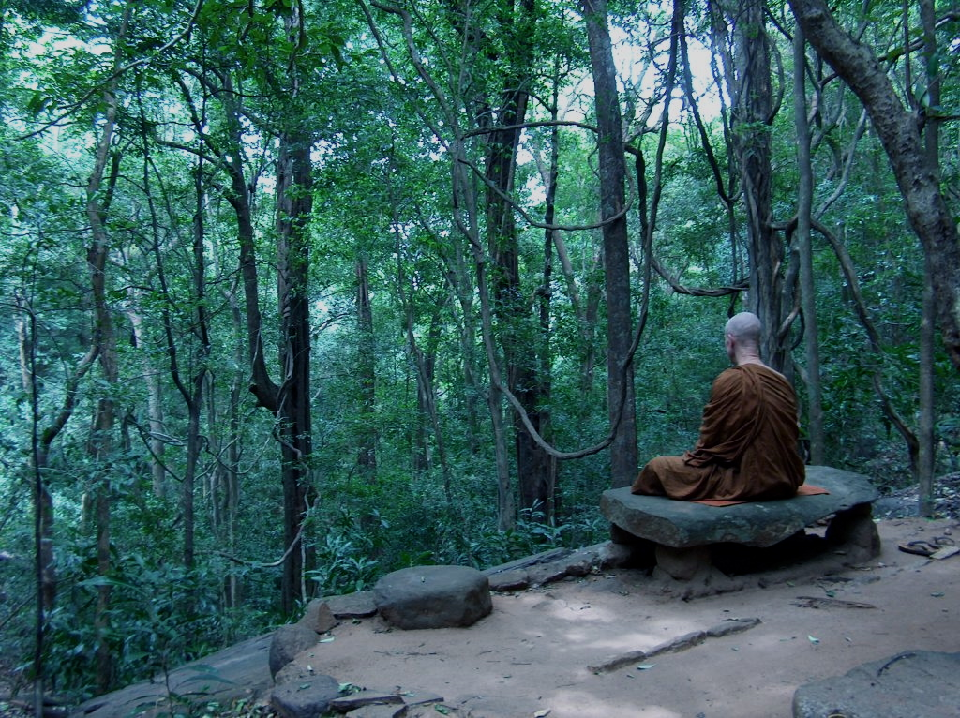
Notes:
Ancient Buddhist monk. First few centuries of Buddhist movement
Folks like these invented meditation
part of a radical counter-cultural movement in ancient India that has rejected the dominant values of his culture: [the importance of family and lineage, caste, accumulation of wealth & possessions, coaxing the gods to grant a happy life through ritual sacrifice]
- left mainstream society; renounced family, name, social position, begs for food; abandoned all possessions
- on guard against longing to return to the love of his parents and siblings.
-he eats mindfully, but not to appreciate the subtle textures and flavors of his food but rather to break the spell of craving for superficial pleasures – he is encouraged, in fact, not to prefer one food over another or to indulge in too more than necessary to keep the body functioning

Slide 9
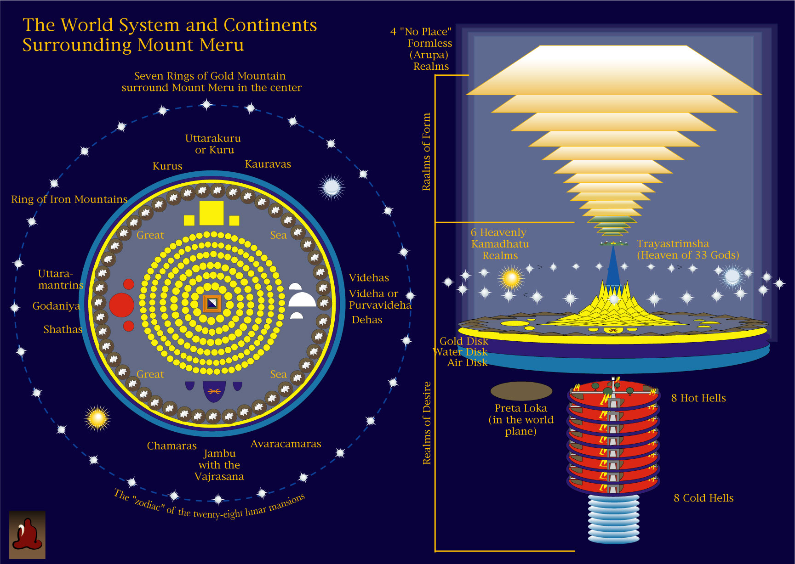
Notes:
His cosmos includes many unseen beings—gods, demons, hungry ghosts—and levels of the world where they dwell—heavens, hells, all on a mandala-shaped flat world

Slide 10
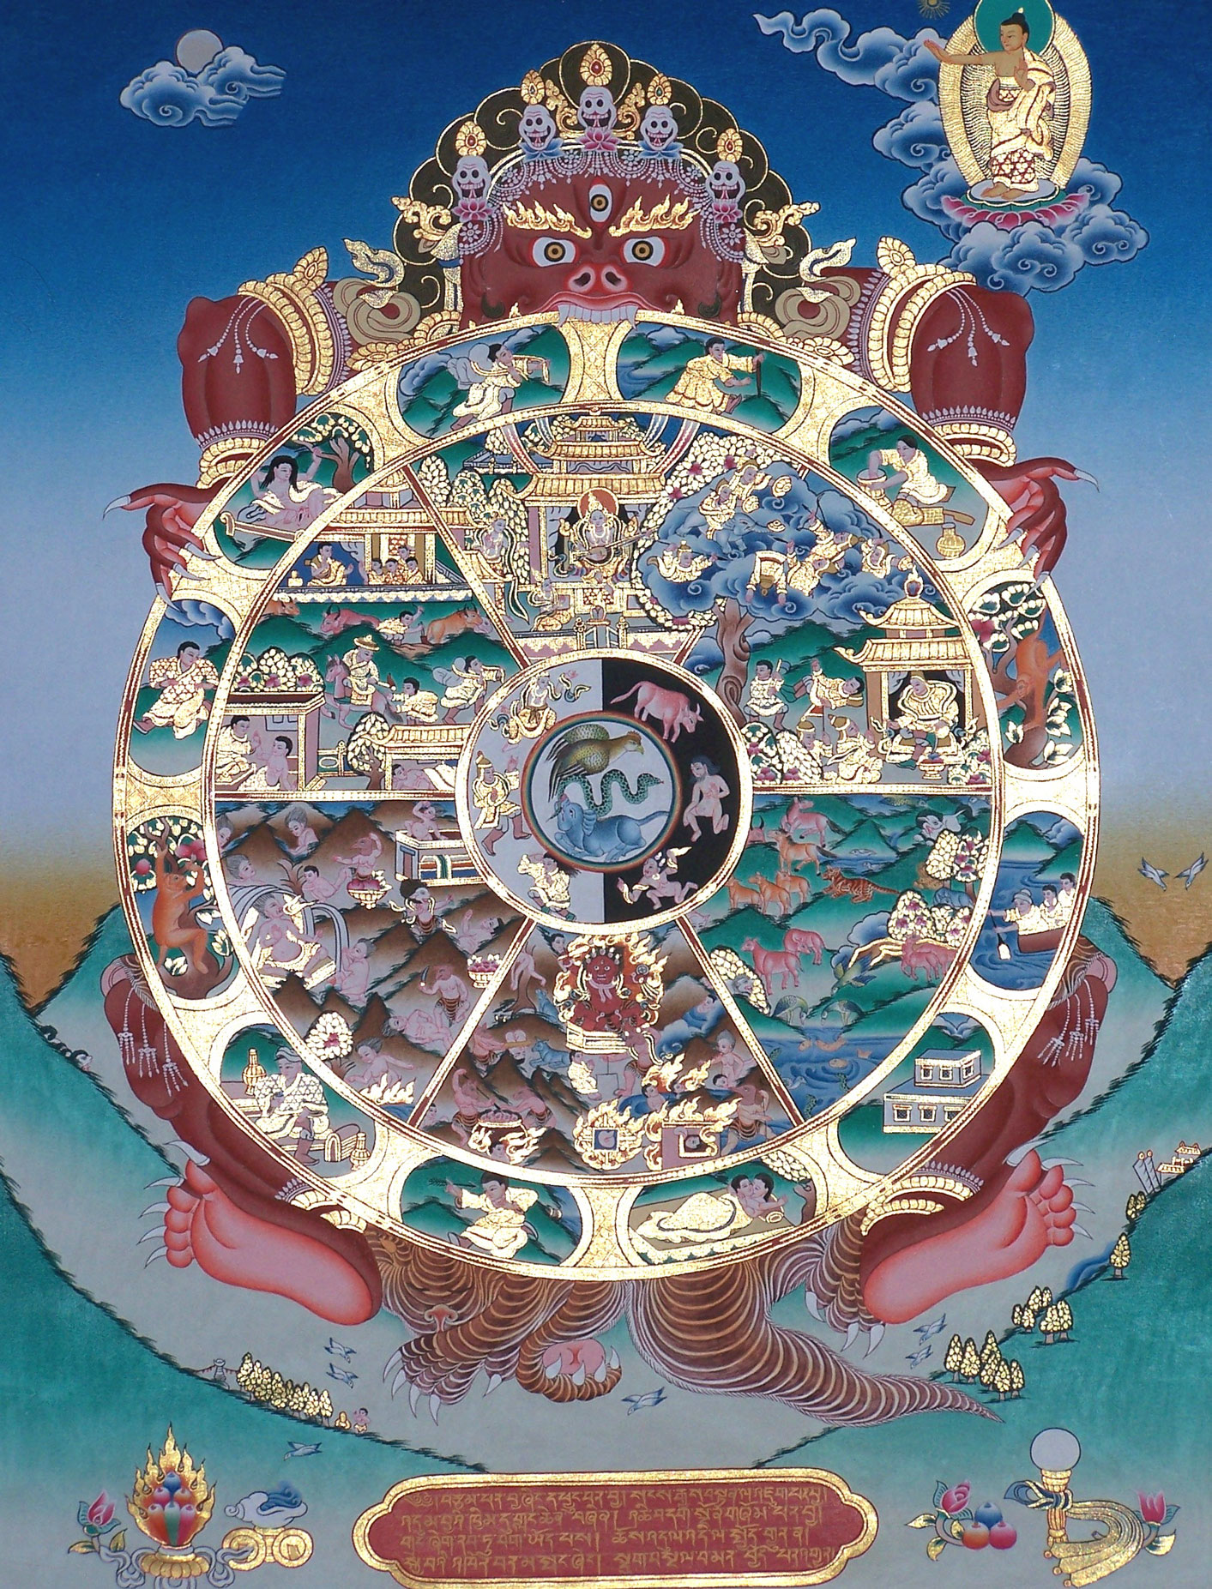
Wheel of Rebirth
Notes:
When he does meditation, he’s not doing it to function better at various worldly activities; he does it ultimately in order to transcend the entire world of samsara, or at least not be reborn as an animal, hungry ghost, or in a hell realm deep under the earth
He is forbidden to attend plays or musical performances
[In thinking about these two figures, I’m reminded of a recent NY Times article summarizing some neuroscience studies of mindfulness, which enumerated the many benefits to various mindfulness practices, including the ability to complete more efficiently several office-related tasks in quick succession (Konnikova 2012). The author says that mindfulness “shifts frontal brain activity toward a pattern that is associated with what cognitive scientists call positive, approach-oriented emotional states—states that make us more likely to engage the world rather than to withdraw from it.”
-contrast to the cultivation of solitude, detachment, and isolation from society recommended for meditation in the early Buddhist texts]
My point is not that one of these figures is authentic or inauthentic or good or bad; only that in order to understand how their contemplative practices work in their lives, we have to understand their social, cultural, historical contexts and the ethics that are implicitly or explicitly woven into them
This suggests that such practices do not simply produce particular, precisely reproducible “states” that are the same across time and space. They are part of larger complexes of ways of being in the world in particular social imaginaries.
Therefore, we need to be careful about making totalizing, universalistic claims like—mindfulness is scientifically proven to make one more sociable
And we could multiply these examples:

Slide 11
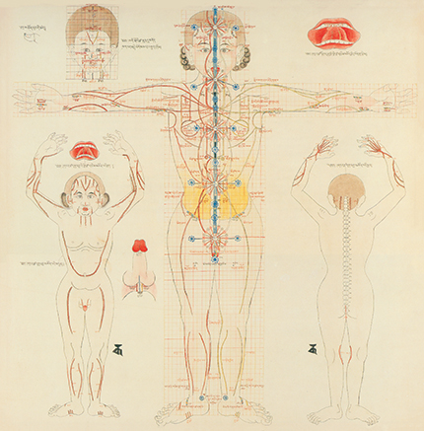
Notes:
Tantric practitioner whose understanding of breath is that it is vital energy whose material manifestation is sexual fluids and who attempts to channel these substances in particular ways during deity yoga or sexual yoga

Slide 12
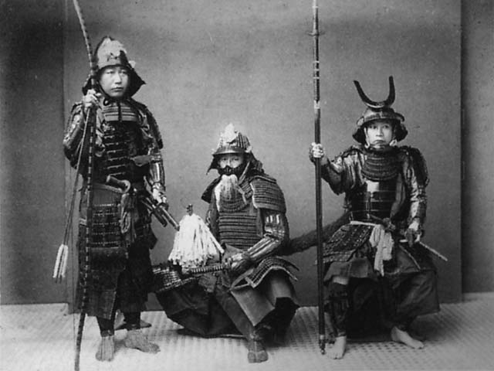
Notes:
Samurai warrior who does breath meditation before going into a swordfight with enemies of his feudal lord

Slide 13

Notes:
And we know now that Buddhist priests trained kamikaze pilots to meditate and maintain mindfulness before going out on their suicide missions for the sake of their country and the emperor
So even if two people are doing the “same” practice in different cultural worlds, they may be cultivating very different ways of being with different goals, values, and ethical orientations.

Slide 14
“mindfulness”
Pāli: sati सतिः
Sanskrit: smṛti स्मृतिः
Notes:
So if we think about the current use of the term mindfulness, which is a translation of these Pali and Sanskrit terms....

Slide 15
Mindfulness: standard (modern) definitions
Scott Bishop: a kind of nonelaborative, non-judgmental, present-centered awareness in which each thought, feeling, or sensation that arises in the attentional field is acknowledged and accepted as it is.
Jon Kabat-Zinn: the awareness that emerges through paying attention on purpose, in the present moment, and nonjudgmentally to the unfolding of experience moment by moment.
Notes:
We might contrast what has become the standardized definitions today, often used in clinical trials, with some of the early Buddhist canonical texts on mindfulness, which, I believe, illustrate the idea that meditation is about cultivating an entire way of being in a particular social imaginary
Briefly: two Buddhist meditation sutras. First, the Arittha Sutta, which introduces breath awareness. The Buddha asks a group of assembled monks if any of them practice mindfulness of breathing, and a monk named Arittha says he does. The Buddha asks him how he practices, and Arittha replies:

Slide 16
Arittha Sutta (SN 54.6)
Arittha: “Having abandoned desire for past sensual pleasures and having gotten rid of desire for future sensual pleasures, and having completely subdued perceptions of aversion regarding internal and external events, I breathe in mindfully and breathe out mindfully.”
Notes:
Closest I’ve come across in Pali and Skt lit to the modern std definition
But here’s what the Buddha says:

Slide 17
The Buddha: “That is mindfulness of breathing in and out, Arittha. I’m not saying it isn’t. But listen and pay careful attention, and I will explain how mindfulness of breathing in and out is brought in detail to its culmination:”
breath, body, rapture, pleasure, mental fabrication, the calming of mental fabrication, the mind, satisfying the mind, concentrating the mind, liberating the mind, impermanence, dispassion, cessation, and relinquishment.
Notes:
The Buddha then presents a more complicated method of mindful attention to the breath, instructing the monks to tether the breathing to various thoughts, feelings, and bodily sensations (Anapanasati sutta). He instructs them to use the breath as a vehicle to concentrate on a succession of sixteen different objects. First is the breath itself, then the body, then various objects of thought and states of mind: rapture, pleasure, mental fabrication, the calming of mental fabrication, the mind, satisfying the mind, concentrating the mind, liberating the mind, impermanence, dispassion, cessation, and relinquishment. Each of these is like a little dharma package that opens up a network of ideas.
“relinquishment” (paṭinissagga) meant abandoning the destructive states of mind (kilesa), mainly greed, hatred, and delusion.
These are not just open-ended observations of whatever arises but conceptual contemplations of various facets of the Dharma. The Buddha is not saying, for example, “when rapture arises, notice it,” though that too might be implied. He is evoking rapture, asking the monks to consider it, to imagine it, to understand it in the larger context of the dharma, to establish it as a possible category of experience—carving out a space for it.
-cessation (of suffering, enlightenment itself) – must imagine it
-So it is actually a rather complicated cognitive task the Buddha is suggesting.

Slide 18
Sutta on the Four Foundations of Mindfulness (Satipaṭṭhāna Sutta, SN 10)
Contemplation of the body:
1. mindfulness of breathing; contemplation of the four postures (standing, sitting, going forward, and lying down)
2. practice of full awareness of various other bodily activities, such as moving the body in various ways, eating, and eliminating waste
3. attention to the foulness of the body: reviewing the physical constituents of the body, particularly the internal organs and various fluids and substances they produce
4. attention to the four elements within the body (earth, water, fire, and air)
5. cremation ground contemplations: reflections on corpses in different stages of decomposition, and reminding oneself that such a fate awaits one’s own body
Notes:
Gets even more complicated in another seminal meditation text, the Sutta on the Four Foundations of Mindfulness

Slide 19
Contemplation of sensation (vedanā): pleasant, unpleasant, or neutral, applied to both “worldly” and “nonworldly” sensations; then contemplation of how such sensations arise and dissipate.
Contemplation of mind (citta), which includes the mind in states of desire, hatred, delusion, contraction, distraction, exaltation, surpassing, concentration, and liberation, as well as the absence of all of these; then the contemplation of how these arise and dissipate.

Slide 20
Contemplation of objects of the mind (dhammas), which include:
a. The five hindrances: sensual desire, ill-will, lethargy, restlessness and worry, and doubt.
b. The five aggregates that constitute a human being: physical form, sensation, perception, volition, and consciousness.
c. The six internal and external sense-bases: eyes and visual objects, ears and sounds, nose and smells, tongue and tastes, body and tangible objects, and mind and objects of thought.
d. The seven factors of awakening – mindfulness, investigation of states, energy, joy, calm, concentration, equanimity.
e. The four noble truths: suffering (dukkha), craving, cessation of suffering, and the eightfold path leading to the cessation of suffering: right understanding, intention, speech, action, livelihood, effort, mindfulness, and concentration.
Notes:
Far from simply being a manual on non-judgmental, non-conceptual bare attention to the breath in the present moment with no goals, lays out an entire way of seeing and being in the world, filled with judgments of right and wrong, attitudes to take toward various phenomena, goals to be achieved, philosophical concepts to be mastered, emotions and intentions to be cultivated and others to be resisted.
And all of this is taking place within a particular counter-cultural monastic movement within the larger Indian culture and cosmos
By the end of the text, one has encountered an entire alternative social imaginary and methods of training the mind to inhabit it

Slide 21
How is contemplative practice and experience configured in accordance with the taxonomy of a particular social imaginary?
How does it work systemically within these contexts?

Slide 22
Edward Shorter on psychosomatic illness:
Each historical period and cultural milieu develops its own “symptom pool” or “symptom repertoire” shaped in part by the available categories, templates, and models of illness established by the medical community itself and by the surrounding culture.
“medical shaping of symptoms” orchestrated by the unconscious
Some mental disturbances manifest in culturally available ways
Authoritative taxonomies penetrate the unconscious, structuring the illness itself.
Notes:
Psychosomatic illness
Not only are the theoretical categories and explanations of psychological illness quite different across cultures and historical periods, but also that the symptoms themselves vary considerably
-hysterical paralysis
-ADHD, anorexia nervosa, etc.—that appear to be products of a particular culture.
Shorter claims that each historical period (and by implication, cultural milieu) develops its own “symptom pool” or “symptom repertoire” shaped in part by the available categories, templates, and models of illness established by the medical community itself and by the surrounding culture. Symptom pools emerge through a dynamic negotiation between the patient, the patient’s unconscious, the doctor, and the broader culture. Patients, according to Shorter, present symptoms that accord with the medical diagnostics of their time and place—what he calls the “medical shaping of symptoms” orchestrated by the unconscious
“illness negotiation,” whereby they would together shape each other’s perceptions of the behavior. In this negotiation the doctor would provide the scientific validation that the symptom was indeed indicative of a legitimate disease category, and new patients would increase the attention focused on the new symptom in the [broader culture], creating a feedback loop that further established the legitimacy of the new symptom
-people have vague, undefined anxieties that manifest through a repertoire of available forms that are authenticated by the medical establishment’s taxonomies of illnesses and symptoms.

Slide 23
On this model, contemplative practices are technologies of self-cultivation that strive to produce certain experiences and cultivate certain ways of being in the world—a world that contains particular normative understandings of a good life, a holy life, a successful life, as well as conceptions of the person, the mind and its features, the potential for human development and cultivation, and various experiences that meditators will have at different stages on the path.
Not “private mental states”
“Experience negotiation”
May disrupt typical taxonomies, help create new ones, reconfigure the social imaginary, develop new experience repertoires
Meditative experience, in this sense, is not the private, empirical observation of mental contents but a dialogical process in systemic relation to the tradition and the broader culture, its categories, and ideals.
Notes:
Similar to other kinds of experience, including meditative
-Meditative practices are modes of self-cultivation that strive to produce certain experiences and cultivate certain ways of being in the world—a world that contains particular normative understandings of a good life, a holy life, a successful life, as well as conceptions of the person, the mind and its features, the potential for human development and cultivation, and various experiences that meditators will have at different stages on the path. In the early Buddhist example, the tradition supplies a view of the human being, moral and attitudinal valuations of various phenomena (the body, sexuality, sense objects), taxonomies of the many phenomena of the lived world (dhammas), and markers of progress in meditation (e.g., the progressively more rarified states of absorption [jhānas]). These provide ways of directing attention and navigating what is significant and insignificant in meditative practice. They provide guidance on fostering or constraining certain thoughts, feelings, emotional dispositions, and ethical motivations, and on developing valued skills and creating (and disrupting, or perhaps transcending) certain culturally available personal identities.
“experience negotiation” e.g., dokusan in Zen
The many and detailed Buddhist maps of the path—the jhānas, lam rim, bhāvanākrama, etc.—as well as the various modern, secular theories of mental health, happiness, meaningful lives—are constructive models that do not simply represent a certain territory but configure it. At least part of the work meditative practices do is to deeply internalize the teachings and taxonomies of the tradition by contemplating them in a concentrated, systematic way, not just deconditioning but reconditioning the mind and body according to these maps.
Novelty happens, individuals find themselves in states not accounted for by tradition, people leap beyond normative ways of being, and categories change and merge to accommodate the new and unexpected.
So the level of analysis that attends only to universal physiological structure and function can’t adequately account for how these practices work in practitioners’ lives. If we are to take seriously the first-person perspective of contemplatives, we must understand how they conceive of the meaning, purpose, and significance of their practices in their doctrinal, social, cultural, and cosmic contexts. To understand contemplative practices in a comprehensive way, therefore, scientific study of meditation must work hand-in-hand with philosophers, anthropologists, sociologists, and scholars of religion who can help articulate these contexts. By all means we should measure what is measurable, but we should not think that such measurements—be they brain-waves, blood flow, respiration, etc.—get down to the real “facts” about meditation to which all other “data” (beliefs, social situation, cultural factors, relations of power) are extraneous. We have to understand all of these factors together systemically.

Slide 24



“Meditation and mindfulness are the new rage in Silicon Valley. And it's not just about inner peace—it's about getting ahead.” – Wired Magazine, 2013
Mindful Sex: Orgasm Anxiety Be Gone!
Notes:
This is important to some of the modern debates about mindfulness
-some have criticized secularized forms of mindfulness for stripping away much of the ethical and philosophical contexts in which these practices have always been embedded
-when stripped of these contexts, bare mindfulness practices may simply be like a dry sponge that absorbs the prevailing cultural values and provides ways of doing, slightly more calming and efficiently, whatever you happened to be doing anyway
-it also makes it susceptible to trivialization and commodification
-mindfulness was originally intended to help people overcome the ”three poisons” of greed, hatred, and ignorance
-some critics have suggested that it has been co-opted by all of these
Solution is not to restrict mindfulness to its traditional Buddhist contexts but to have more robust conversations about what mindfulness is meant to do, what kind of transformations it is should entail, and what ethical orientations it is intertwined with in current social and cultural contexts.

